Slide 1
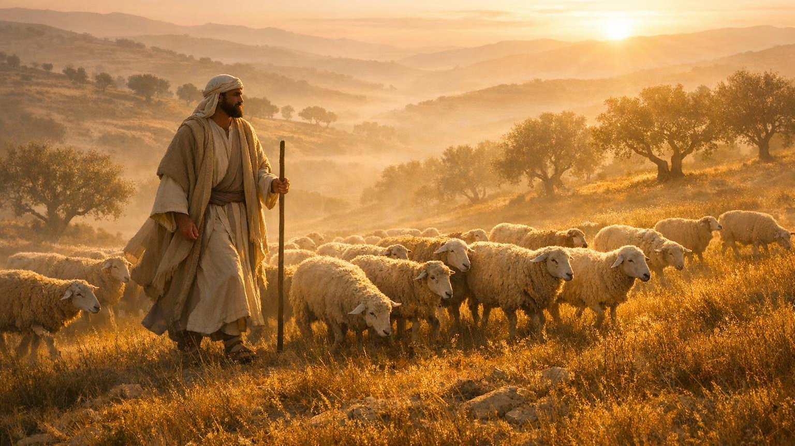
The Love of Christ Compels Us
II Corinthians 5:14
Notes:
Eddie Williams ~ June 7, 2026

Slide 2
II Corinthians 5:14 (NKJV)
For the love of Christ compels us, because we judge thus: that if One died for all, then all died;

Slide 3
What does it mean that the love of Christ compels us?
Second Corinthians 5:14 says, “For Christ's love compels us, because we are convinced that one died for all, and therefore all died.” In this verse, Paul speaks of his motivation for ministry.

Slide 4
There are as many different types of motivations as there are personalities. And of course, the intensity of those motivations can range from mild to obsessive.
A young teen might babysit on the weekends because she’s motivated to save up for a new phone.

Slide 5
The leader of a free country might be willing to sacrifice the lives of thousands of soldiers in order to protect the lives and liberties of those in his realm.
Without the right motivation, very little progress can be made in anything.

Slide 6
Jesus spoke of the importance of motivation when contrasting the hireling and the shepherd. The hireling will take care of the animals because he wants to get paid. But as soon as he sees danger (that is, when wolves appear), he abandons the sheep to protect himself.

Slide 7
The shepherd, on the other hand, not only takes care of his flock, but he’s willing to put his life on the line to keep them safe (John 10:7–18).

Slide 8
When the apostle Paul wrote, “The love of Christ compels us,” he was describing the powerful, Spirit-filled motivation that drives followers of Christ to share the gospel in ways that persuade people to commit their lives to Jesus.

Slide 9
When Paul explained this motivation to the Corinthians, he wanted them to not be ashamed of either him or the message of reconciliation that brings life to those who embrace it (2 Corinthians 5:11–15). Paul understood the futility of life without Christ and the empty pursuit of righteousness through self-effort.

Slide 10
Even though the people to whom he preached were often hostile to him, and even called him crazy, the love of Christ compelled him to keep putting the message of hope in front of them. Paul knew that his detractors were starving for a sense of meaning, purpose, and significance in the world—much like we see today.

Slide 11
The love of Christ compelled Paul to share the gospel. The phrase the love of Christ could be interpreted in two ways: Christ’s love for people, or the apostles’ love for Christ. Either provides motivation to take the gospel to distant lands in the face of opposition.

Slide 12
The great love of Christ was such that “Christ died for all” people (2 Corinthians 5:14, NLT). Paul’s love for Christ was such that he was willing to die to self (see Galatians 2:20).

Slide 13
This testimony of Paul’s encourages us to ask ourselves, “What motivates us to share the good news of Jesus with others?” Are we driven by a genuine love and affection for Christ, by a clear view of Christ’s love for the lost, or merely by a sense of duty? What motivates us will make all the difference.

Slide 14
When we possess this compelling, Spirit-driven motivation of Christ’s love, we are zealous in seeing the lost reconciled with God. We go to the lost, rather than letting them come to us. We are willing to make ourselves “a slave to everyone, to win as many as possible” (1 Corinthians 9:19);

Slide 15
we “become all things to all people so that by all possible means [we] might save some” (verse 22).
The love of Christ compels us to love the lost enough to share the good news of salvation with them.

Slide 16
The Church Must be Organized to Go Effectively

Slide 17
Ephesians 4:11-12 (NASB)
¹¹ And He gave some as apostles, some as prophets, some as evangelists, some as pastors and teachers, ¹² for the equipping of the saints for the work of ministry, for the building up of the body of Christ;

Slide 18
Acts 8:4 (NASB)
Therefore, those who had been scattered went through places preaching the word.

Slide 19
Matthew 12:38-40 (NASB)
³⁸ Then some of the scribes and Pharisees said to Him, "Teacher, we want to see a sign from You." ³⁹ But He answered and said to them, "An evil and adulterous generation craves a sign; and so no sign will be given to it except the sign of Jonah the prophet;

Slide 20
Matthew 12:38-40 (NASB)
⁴⁰ for just as JONAH WAS IN THE STOMACH OF THE SEA MONSTER FOR THREE DAYS AND THREE NIGHTS, so will the Son of Man be in the heart of the earth for three days and three nights.

Slide 21
Ephesians 4:16 (NASB)
from whom the whole body, being fitted and held together by what every joint supplies, according to the proper working of each individual part, causes the growth of the body for the building up of itself in love.

Slide 22
Matthew 28:19-20 (NASB)
¹⁹ "Go, therefore, and make disciples of all the nations, baptizing them in the name of the Father and the Son and the Holy Spirit, ²⁰ teaching them to follow all that I commanded you; and behold, I am with you always, to the end of the age."

Slide 23

…that Christ died for our sins according to the scriptures;
And that he was buried, and that he rose again the third day according to the scriptures:

Slide 24

Hear: Romans 10:17
So then faith cometh by hearing, and hearing by the word of God.

Slide 25
Believe: Hebrews 11:6
But without faith it is impossible to please him: for he that cometh to God must believe that he is, and that he is a rewarder of them that diligently seek him.

Slide 26
Repent: Luke 13:3
I tell you, Nay: but, except ye repent, ye shall all likewise perish.

Slide 27
Confess: Matthew 10:32-33
32 Whosoever therefore shall confess me before men, him will I confess also before my Father which is in heaven.
33 But whosoever shall deny me before men, him will I also deny before my Father which is in heaven.

Slide 28
Baptize: Acts 22:16
And now why tarriest thou? arise, and be baptized, and wash away thy sins, calling on the name of the Lord.

